Slide 1
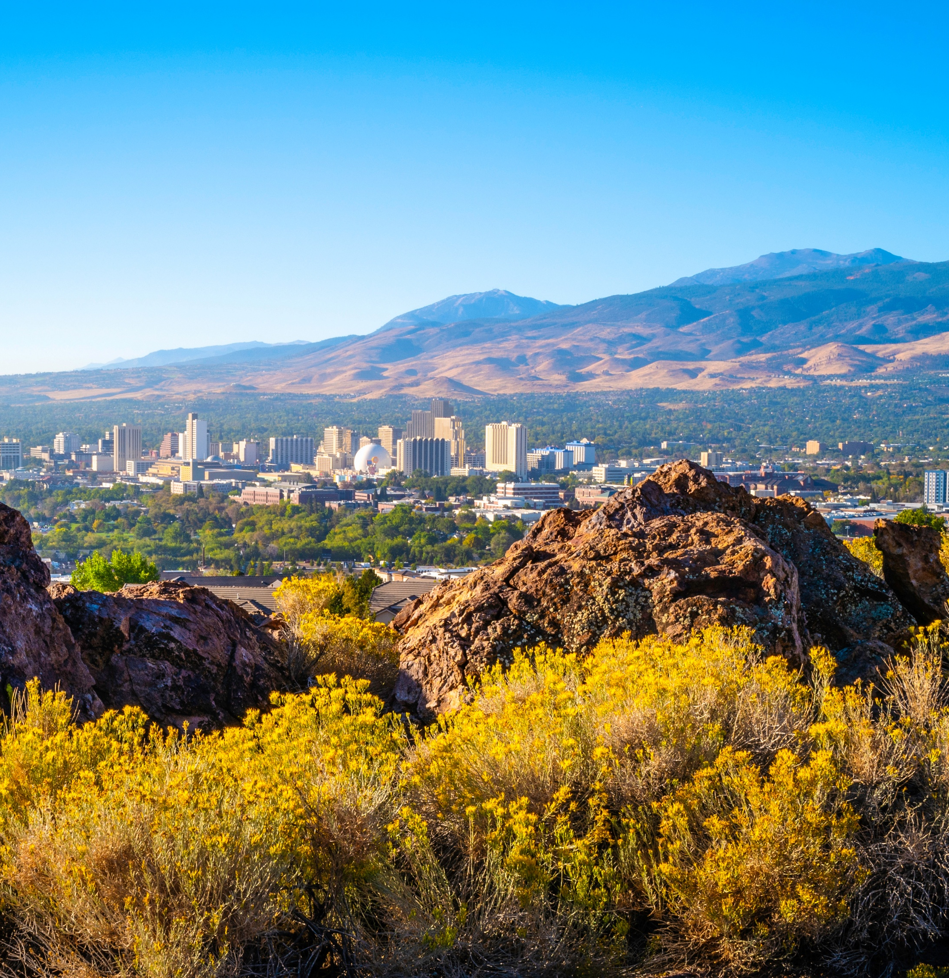
RTC Projects
Nevada Transportation Conference
May 14, 2025

Slide 2


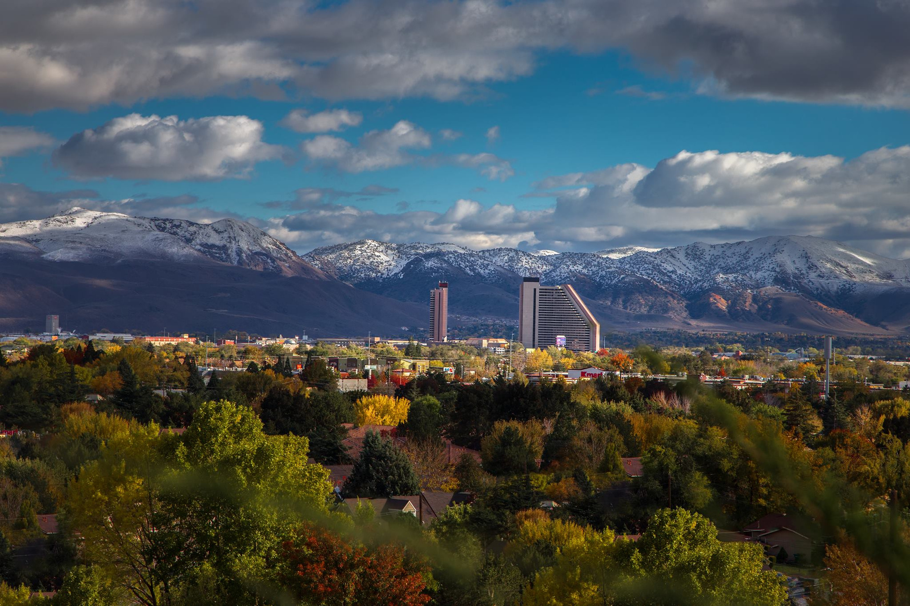
Who Doesn’t Love
a Good Project?
Notes:
9:10 – Chair Hill – 10 min.

Slide 3
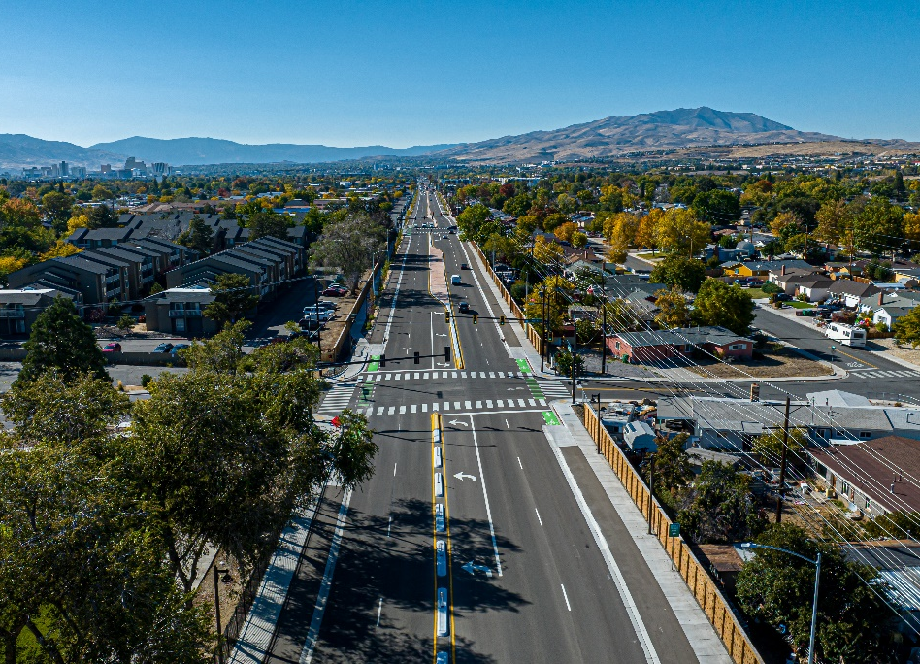
RTC Projects
2024 Major Accomplishments
  Oddie/Wells Project
  I-580 Exit 29/S. Virginia St. Operations
  Steamboat Parkway Improvements
Active Projects
  60+ Active Projects
    20+ Construction Projects in 2025
  10+ New Projects Starting in FY 2026

Slide 4
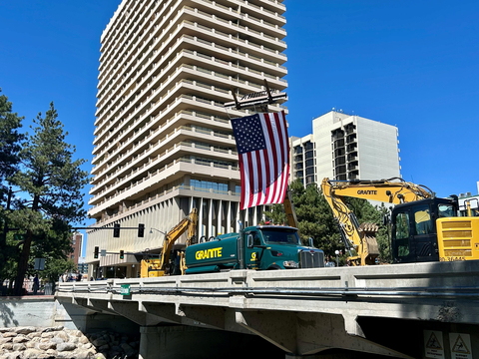
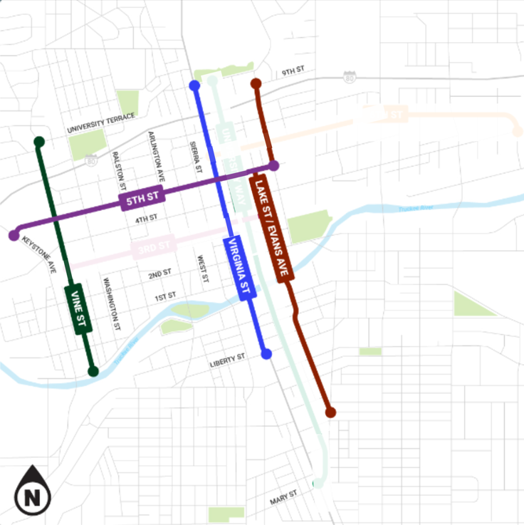
RTC Projects
2025 Construction Projects
  Mill Street Safety and Capacity
  Arlington Bridges
  Sparks Boulevard
  Veterans Roundabout Modifications
Ongoing Design Projects
  Military Road Capacity and Safety Project
  Biggest Little Bike Network
  Pembroke Drive Capacity and Safety Project
  Sun Valley Corridor Improvements – Phase 2

Slide 5
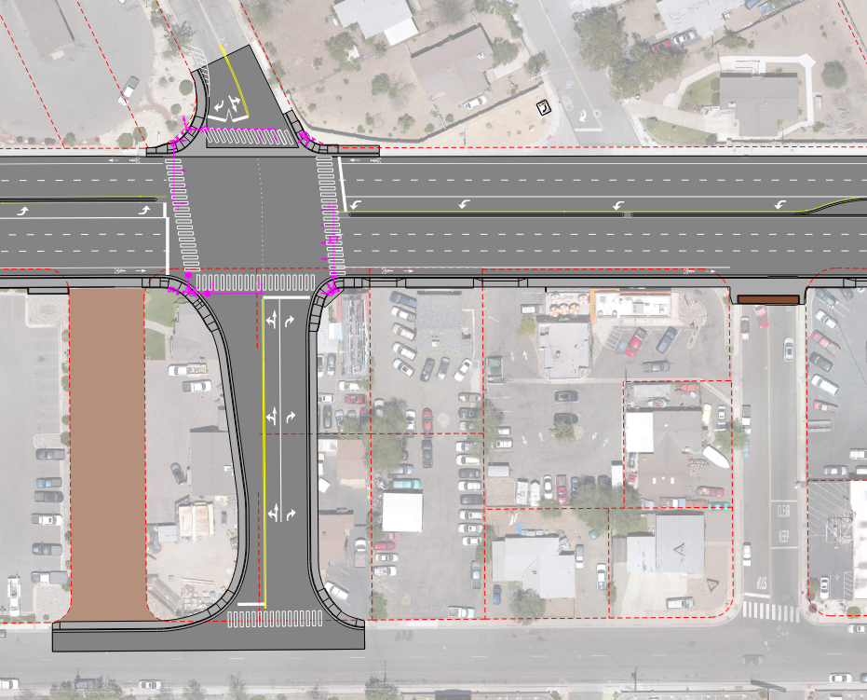

Mill Street Capacity and Safety Project
Kietzke Lane to Terminal Way
Realign Redwood Place and New Signal at Golden Lane
New Westbound Lane
Safety Enhancements
ADA and Multi-Modal Improvements
Construction Underway
$16.6m Local Funds
Golden
Ln.
Reservation
Rd.
Mill St.
I580→
Redwood Pl.
Golden Ln.
Louise St.
Market Street

Slide 6
Arlington Avenue Bridges Project
Replace the two nearly century old bridges that span the river across Wingfield Park in the heart of Downtown Reno
Island Avenue and West First Street
RAISE Grant
CMAR, $32.7m
Construction Underway

Slide 7
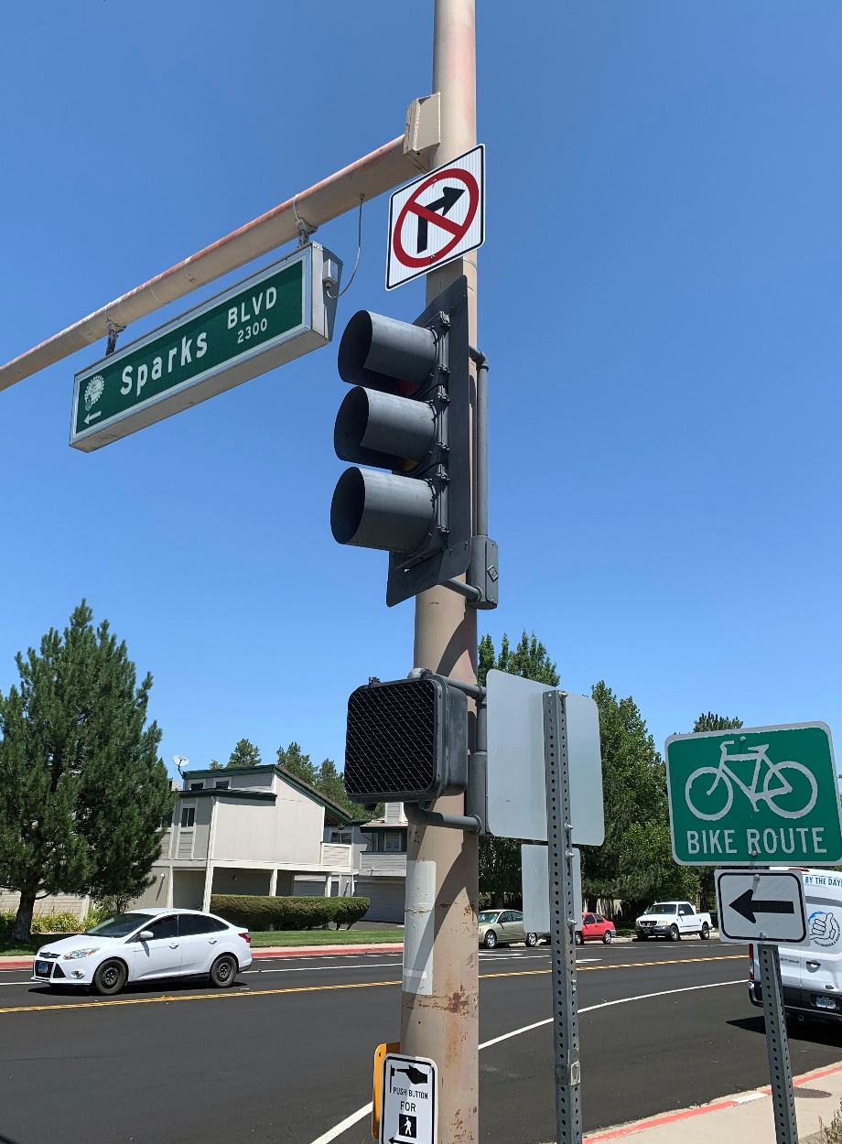
Sparks Boulevard Project
Interstate 80 Westbound Ramps to Baring Boulevard
Widening to 3 Lanes in Each Direction
Shared Use Path
Traffic Operations Improvements
Environmental Mitigation to North Truckee Drain
Sound Walls
Roadway Rehabilitation
$60 million STBG funding
Construction Summer 2025

Slide 8
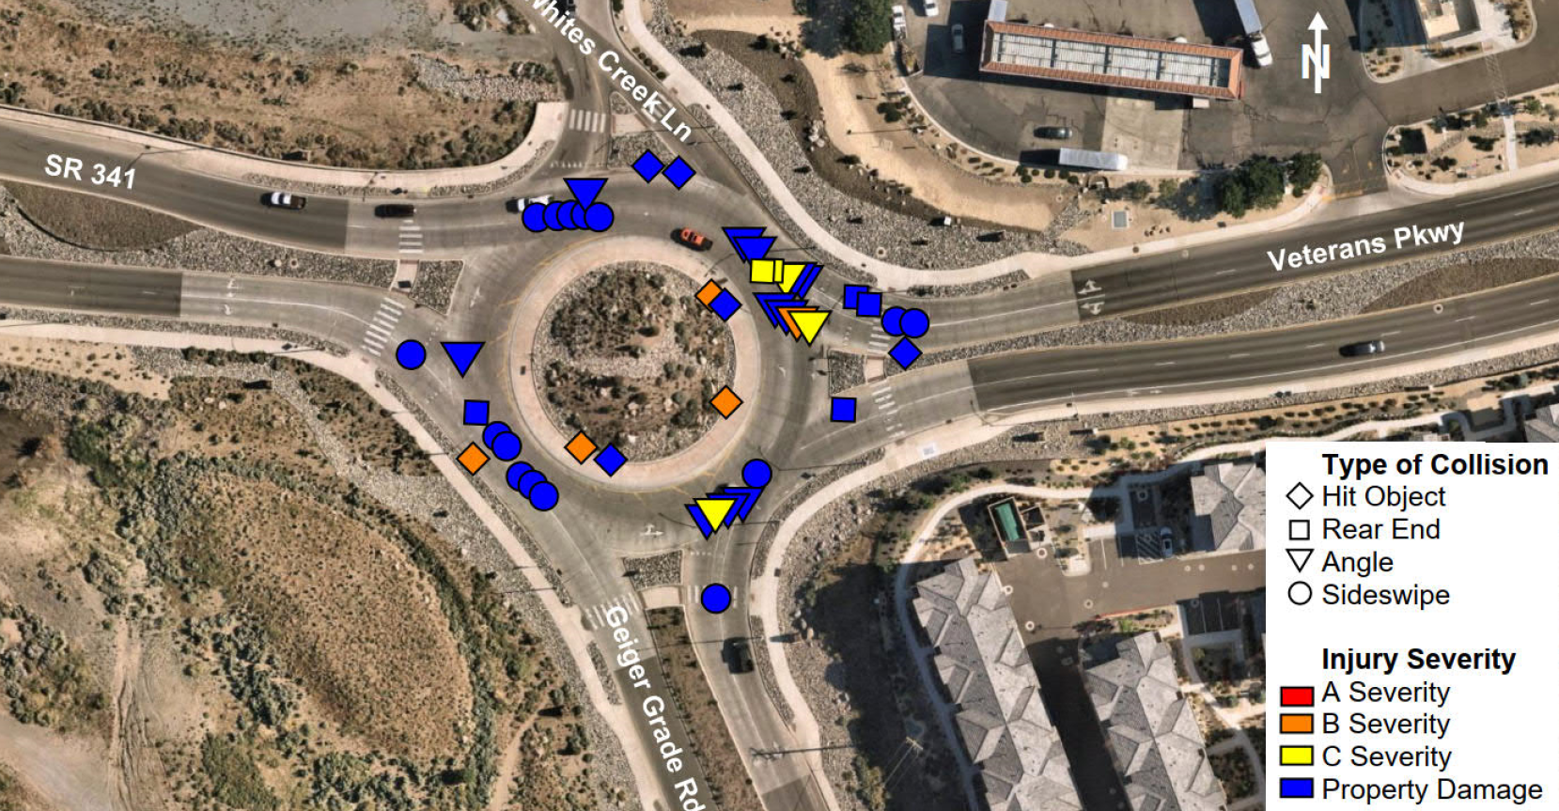
Veterans Roundabout Modifications
State Rute 341, Veterans Parkway, and Geiger Grade Road
Add Eastbound to Southbound Channelized Slip Lane
Additional Through Lane Eastbound
Modifying Geometry to Improve Safety (Conflict Points)
Concrete Paving Replacement
Duel Righthand Turn Lanes SR 341 to Northbound Virginia Street
Pedestrian Safety and Lighting Improvements
$5.9 million local funding
Construction Summer 2025

Slide 9
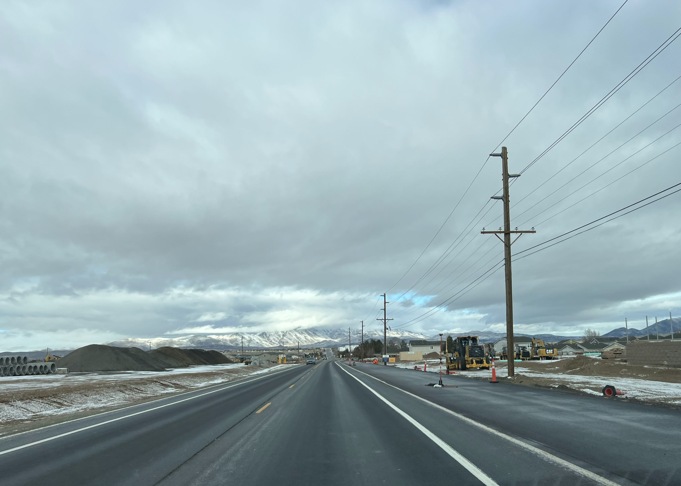
Military Road Capacity and Safety Project
Lemmon Drive to Lear Boulevard
Enhanced traffic flow and safety
Increased roadway capacity
Multimodal Improvements
  Shared Use Path
Drainage Improvements
Utility Relocations
$30 Million, Regional Road Impact Fees
Construction 2026

Slide 10

Biggest Little Bike Network
Four Identified Routes
Vine Street
Virginia Street
Sinclair Street, Lake Street, Evans Avenue
5th Street
Improvements for Biking and Walking
Connect Midtown/Old Southwest to Northside of I-80, Especially the University Area
Estimated $14,000,000 Construction Cost
Construction expected 2026

Slide 11
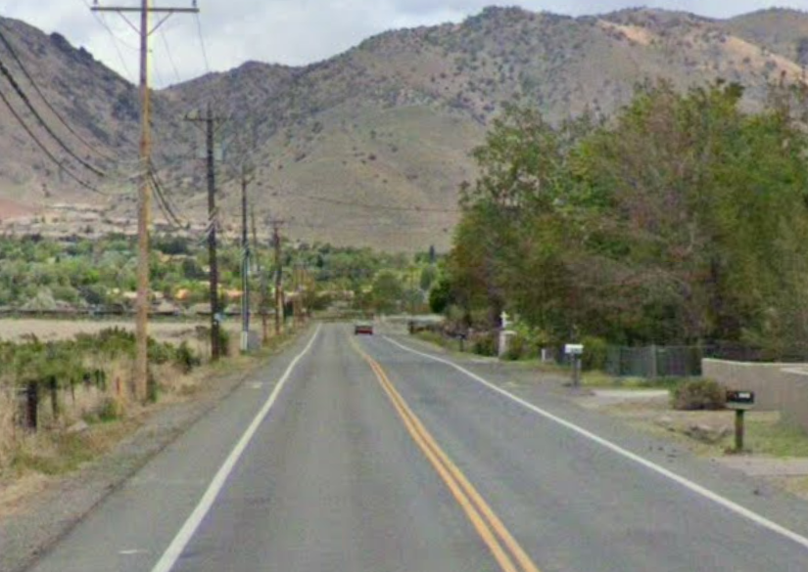
Pembroke Capacity and Safety Project
Improve capacity and safety along Pembroke Drive from South McCarran Boulevard to Veterans Parkway
Widening Pembroke Drive to 4 Lanes
Connect Existing Multi-Use Paths on McCarran Boulevard and Veterans Parkway
Storm Drain Improvements
Flood Channel
Estimated $13,000,000 Construction Cost
Construction expected 2026

Slide 12
Sun Valley Boulevard Corridor Improvements (Phase 2)
Scottsdale Road to 7th Street
Storm Drain Improvements to Capture 100-Year Flood
Multimodal Improvements
  New shared-use paths (separated except where width is constrained), new or improved crosswalks, pedestrian crossing enhancements and accessibility improvements
Signal modifications and fiber optics
Accessible Bus Stop Pads and Amenities
Estimated $74,000,000 Construction Cost
Construction in 2027

Slide 13
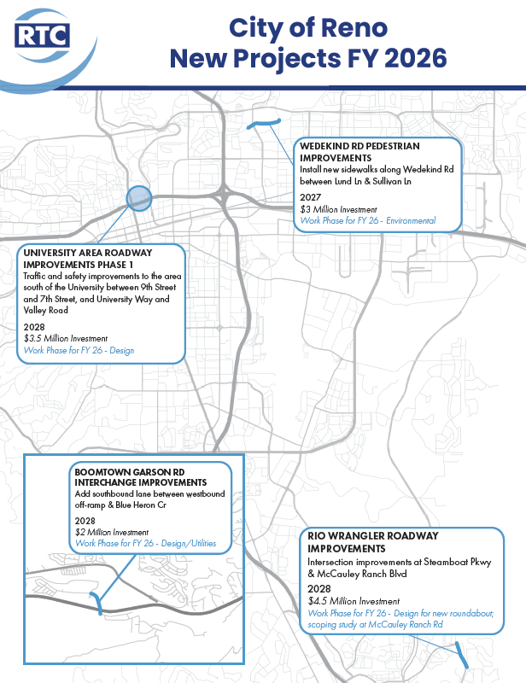
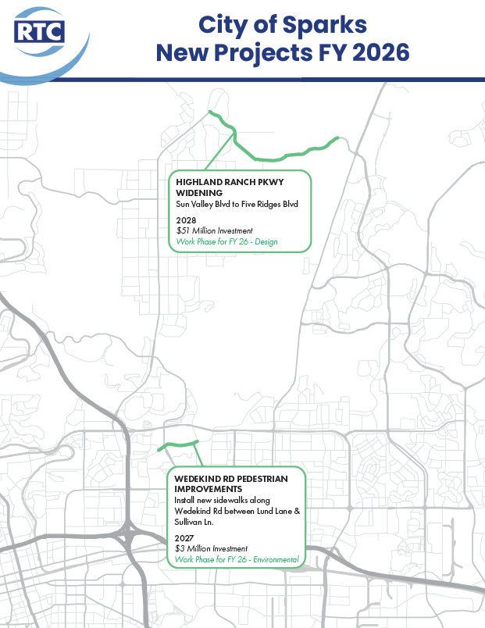
New FY26 Street & Highway Projects

Slide 14

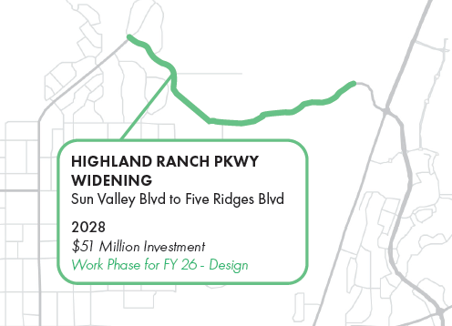

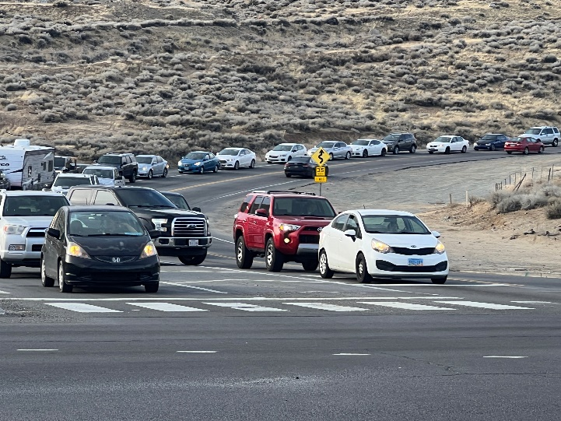
Highland Ranch Parkway Widening Project
Roadway widening from 2 lanes to 4 lanes, continuous pedestrians & multimodal facilities, and improved intersection operations
Limits
Sun Valley Blvd to Five Ridges Blvd
FY26 Work Phase
Design
Construction
2028

Slide 15
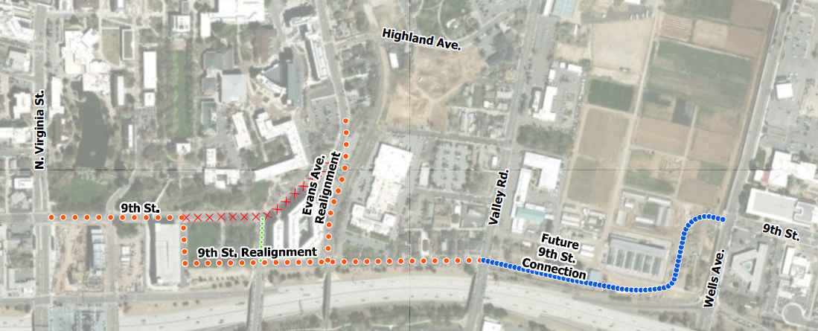
University Area Roadway Improvements
Traffic and safety improvements to the area south of the University.
Limits
9th St., Evans Ave., Lake St.
FY26 Work Phase
Design
Construction
2028

Slide 16
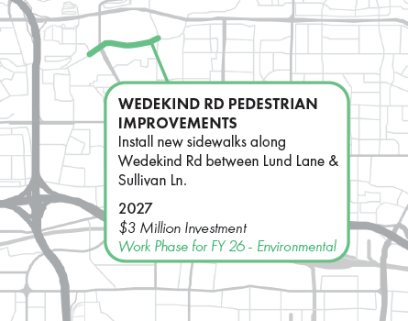
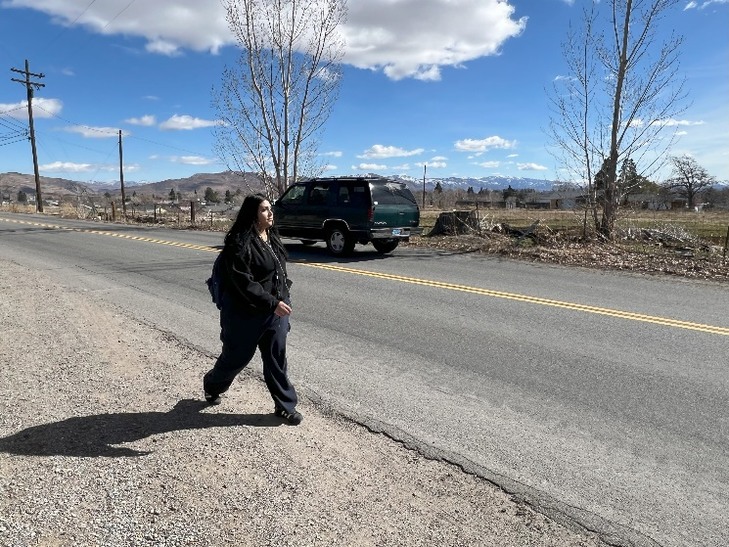
Wedekind Road Pedestrians Improvements
Install new sidewalks and improve pedestrian safety and accessibility.
Limits
Lund Lane and Sullivan Lane
FY26 Work Phase
Design
Construction
2027

Slide 17
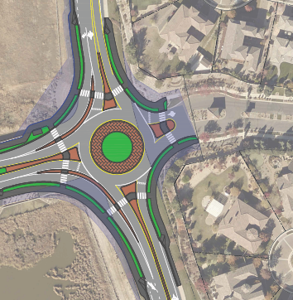
Rio Wrangler Roadway Improvements Project
Intersection improvements at Steamboat Pkwy and McCauley Ranch Blvd
Limits
Western Skies Dr. to Steamboat Pkwy
FY26 Work Phase
Design of New Roundabout at Steamboat Parkway
Scoping Study at McCauley Ranch Boulevard
Construction
2028, Roundabout at Steamboat Pkwy

Slide 18
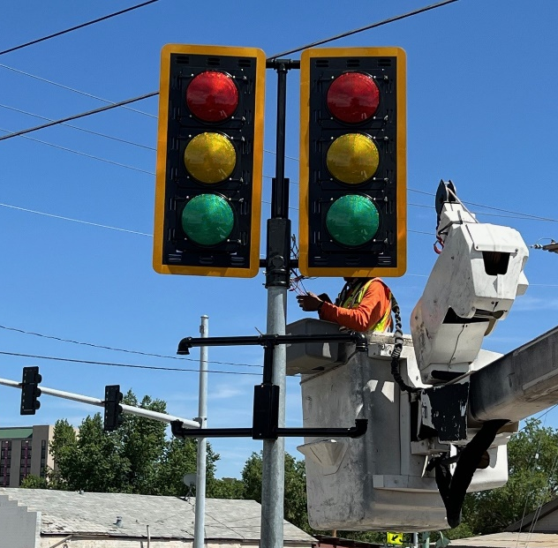
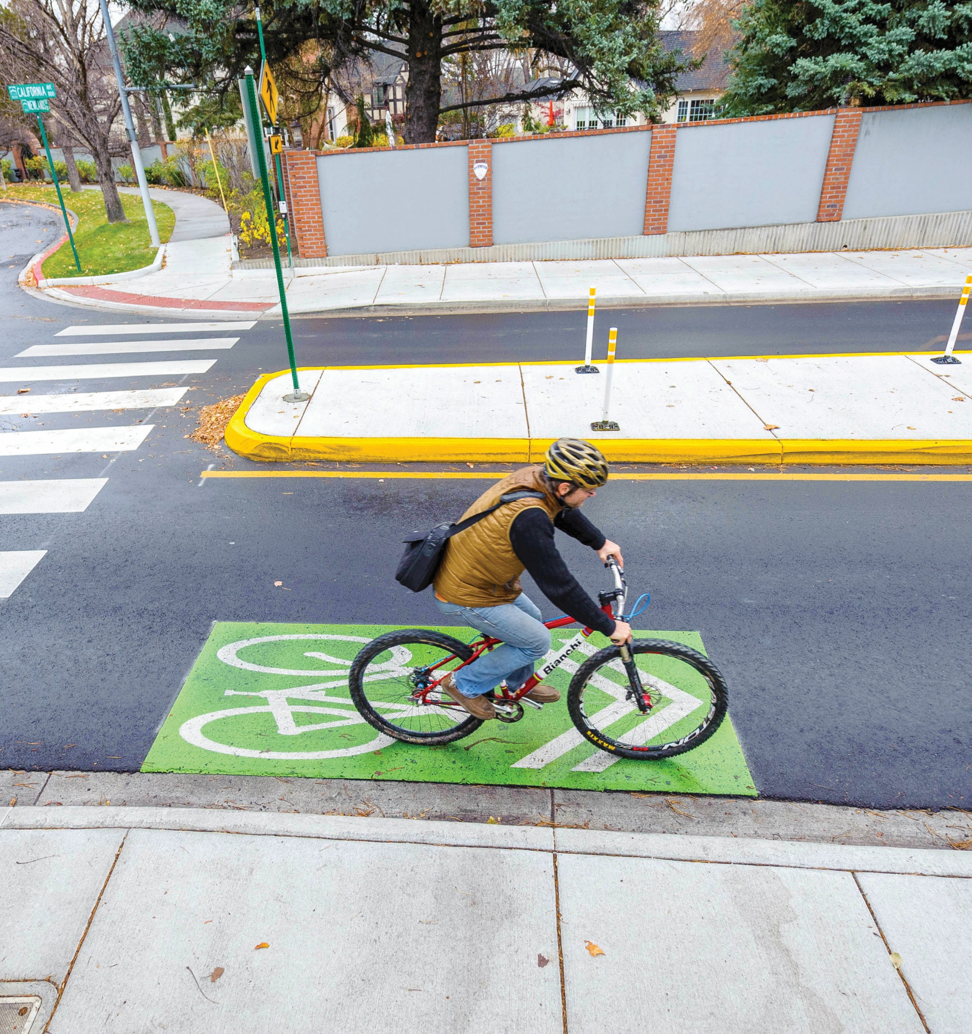
FY26 Region-wide Programs
Pavement Preservation & Reconstruction
  $22.5 Million annual budget (target to performance)
  Pavement Preservation Group project selection
    12 Million Sqft of Regional Roads repaved in 2024
    Pavement Condition Index = 80
Traffic & Intelligent Transportation Systems
  $10 Million annual Budget
  Traffic Operations & Management (TOMS) Group project selection
    Traffic Signals and Signal Modifications
    New Fiber Optic Connections
    Signal Timing
Active Transportation Program (ATP)- NEW
  $5 Million annual budget
  Active Transportation Technical Advisory Committee (ATTAC)
    Recommendations out of Neighborhood Network Plans

Slide 19
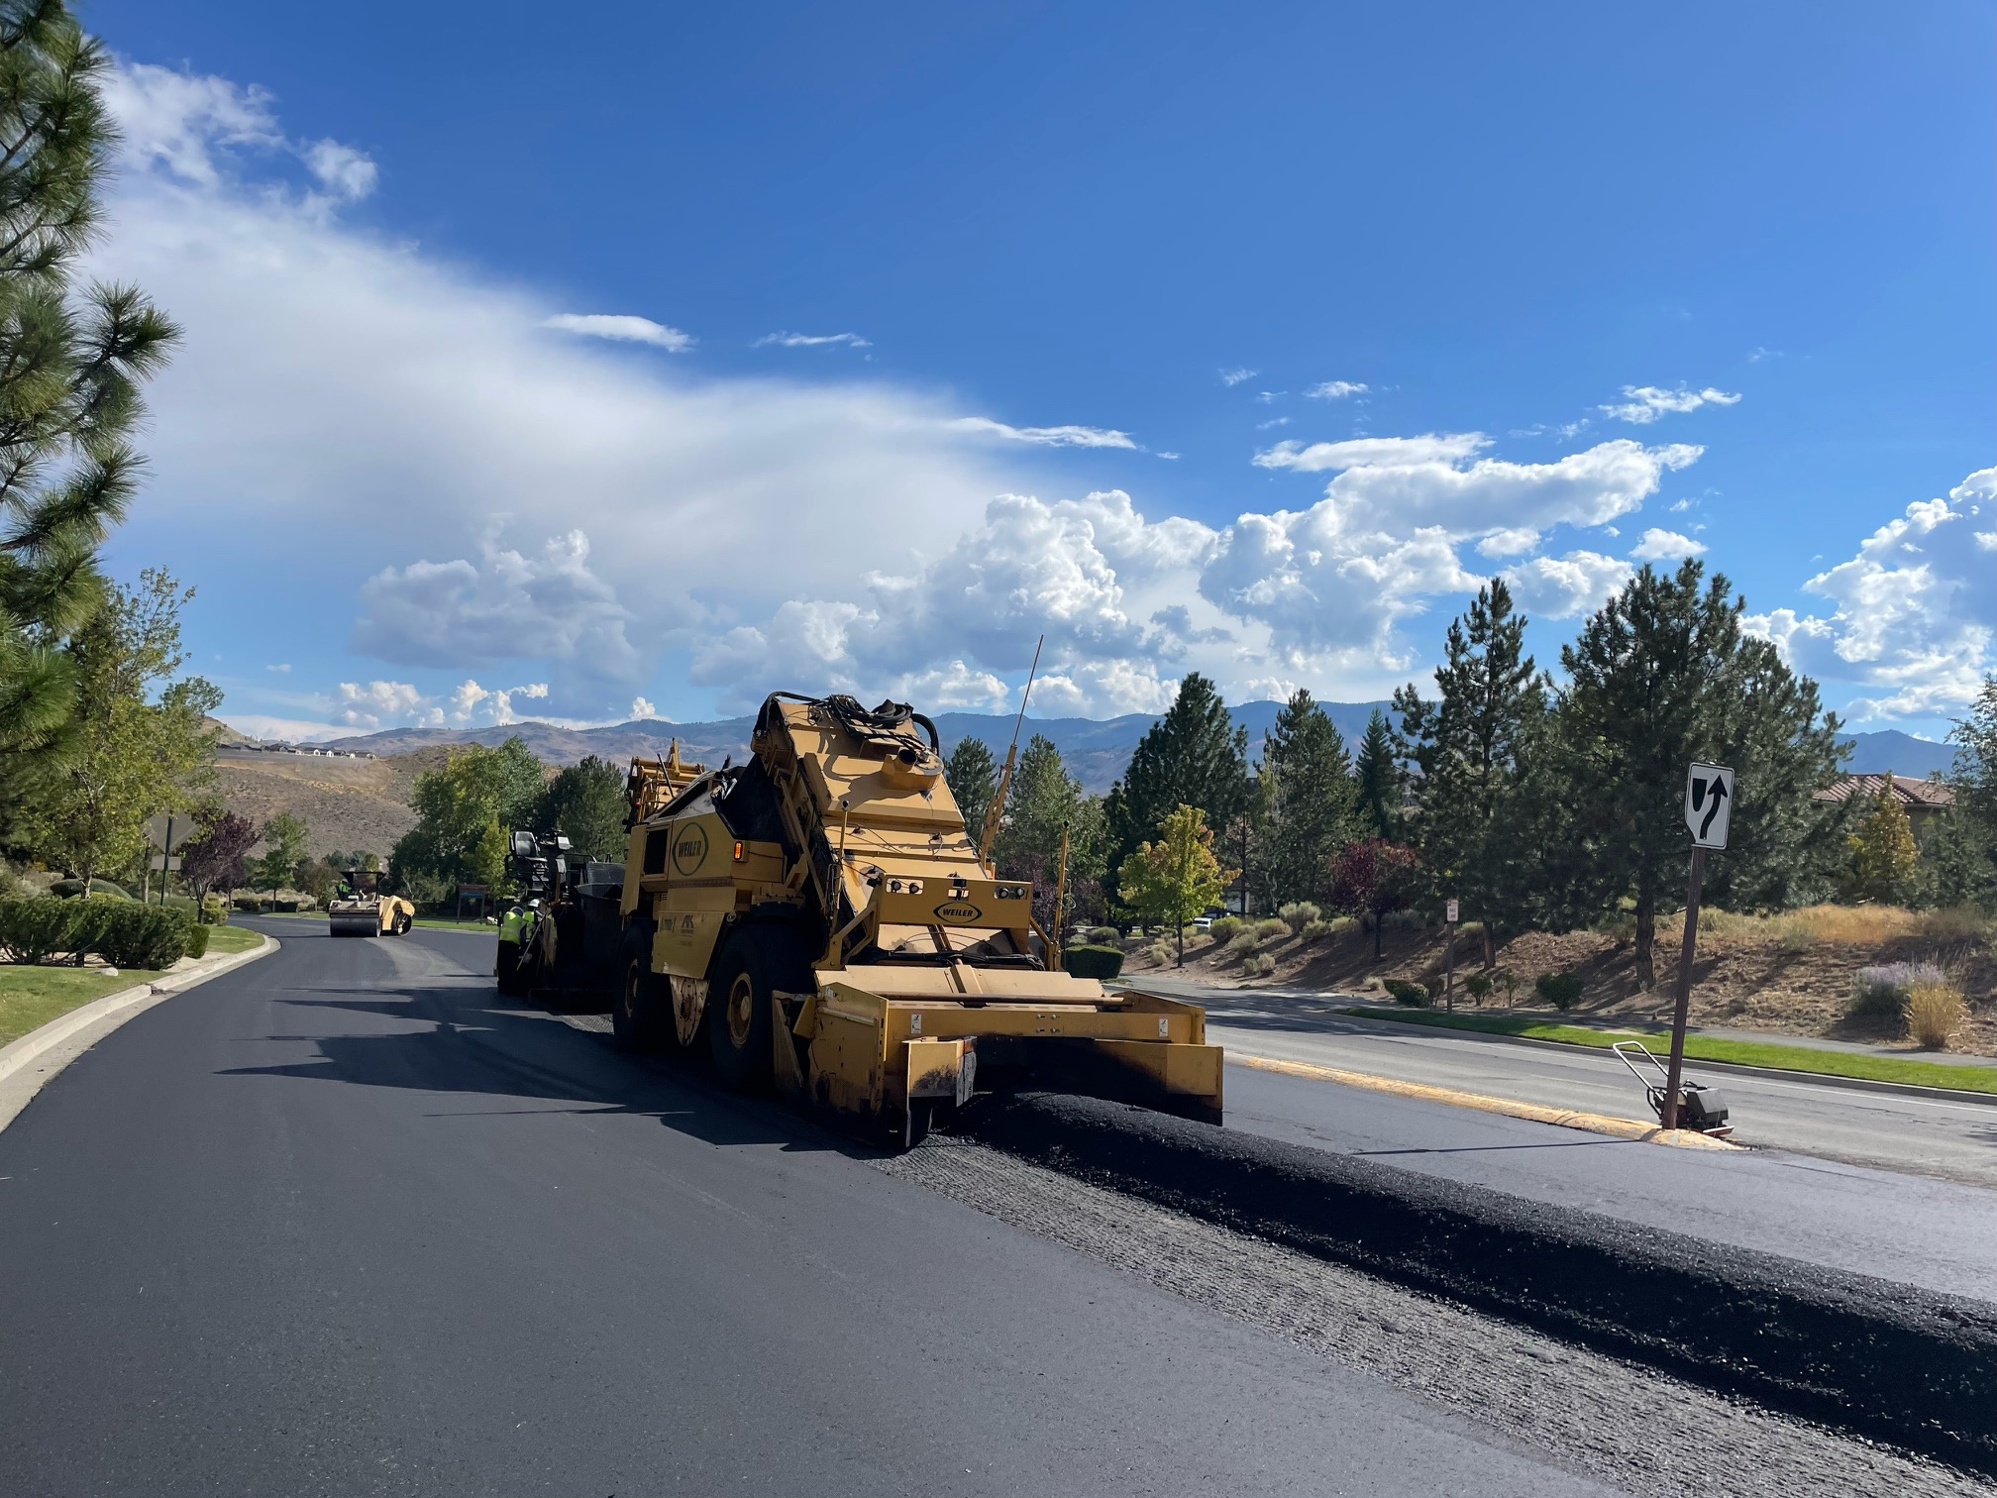
Pavement Preservation & Reconstruction
Pavement Rehabilitation, Corrective Maintenance, and Preventative Maintenance
Smithridge Drive
Pavement Rehabilitation
Peckham Lane to South McCarran Boulevard
Keystone Avenue
Pavement Rehabilitation
North McCarran Boulevard to Coleman Drive
Corrective 2027
Mill and Fill, Patching
Preventative 2027
Microsurfacing, Patching

Slide 20
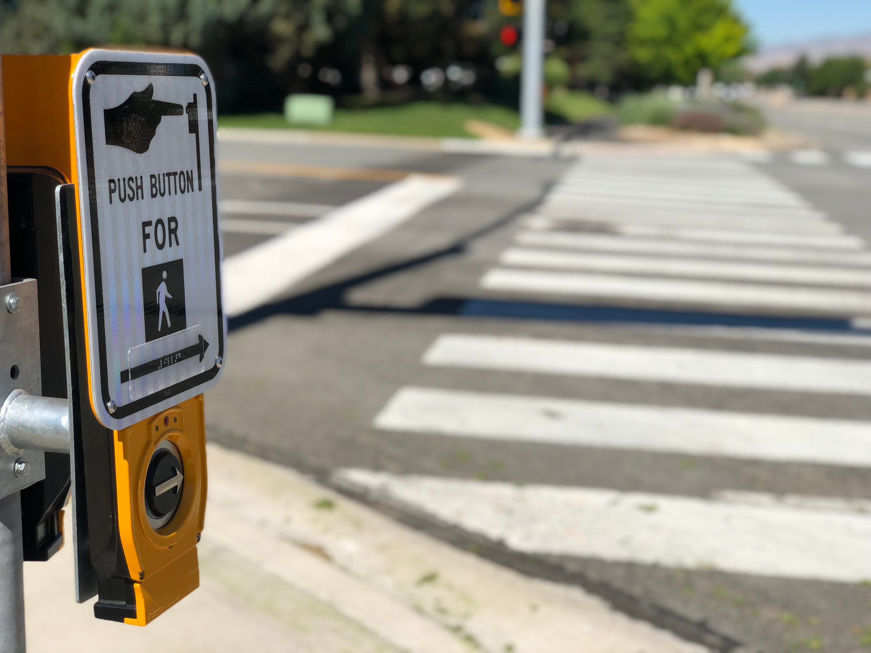
Traffic & Intelligent Transportation Systems
Signal Installation, Signal Modifications, Traffic Safety, and Fiber Optic Installation
McCarran/Mira Loma
Intersection Improvements
Access Control
Rock & Hymer
Intersection Improvements
RRFB’s at Multiple Locations
Sierra & 9th Street
Intersection Improvements
Overhead RRFB’s at Multiple Locations

Slide 21
RTC Engineering Activities
Special Engineering Studies
  Intersection Control Evaluations
  Signal Warrants
  Other Traffic Engineering Studies
Scoping Studies
  O’Brien Pass (Sun Valley to Golden Valley)
  North Hills Boulevard
  North Hills Extension to Panther Drive
  Vista Boulevard Widening
  Highland Ranch Parkway Widening
  Mt. Rose Corridor Improvements (Roundabouts)
  Lear Boulevard Extension
Orange Book Update
  2026 Version

Slide 22
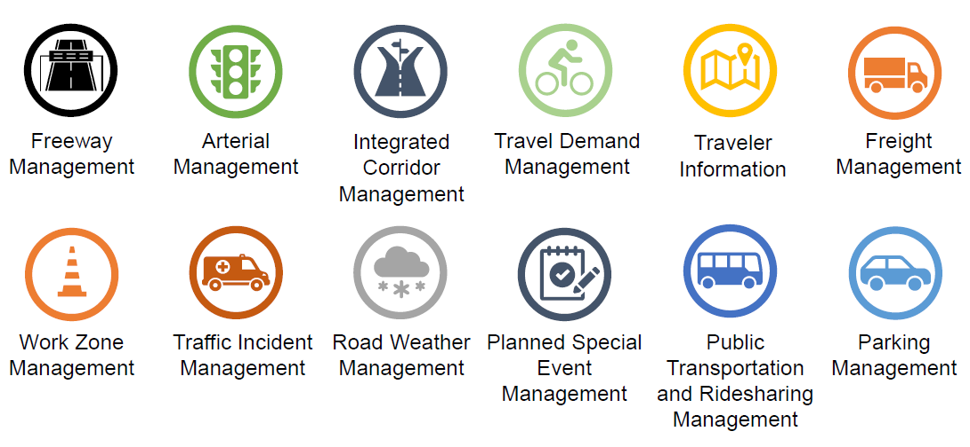
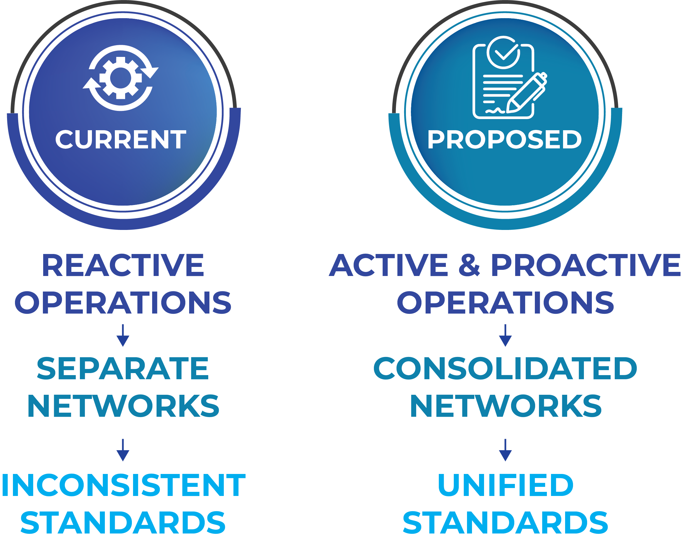
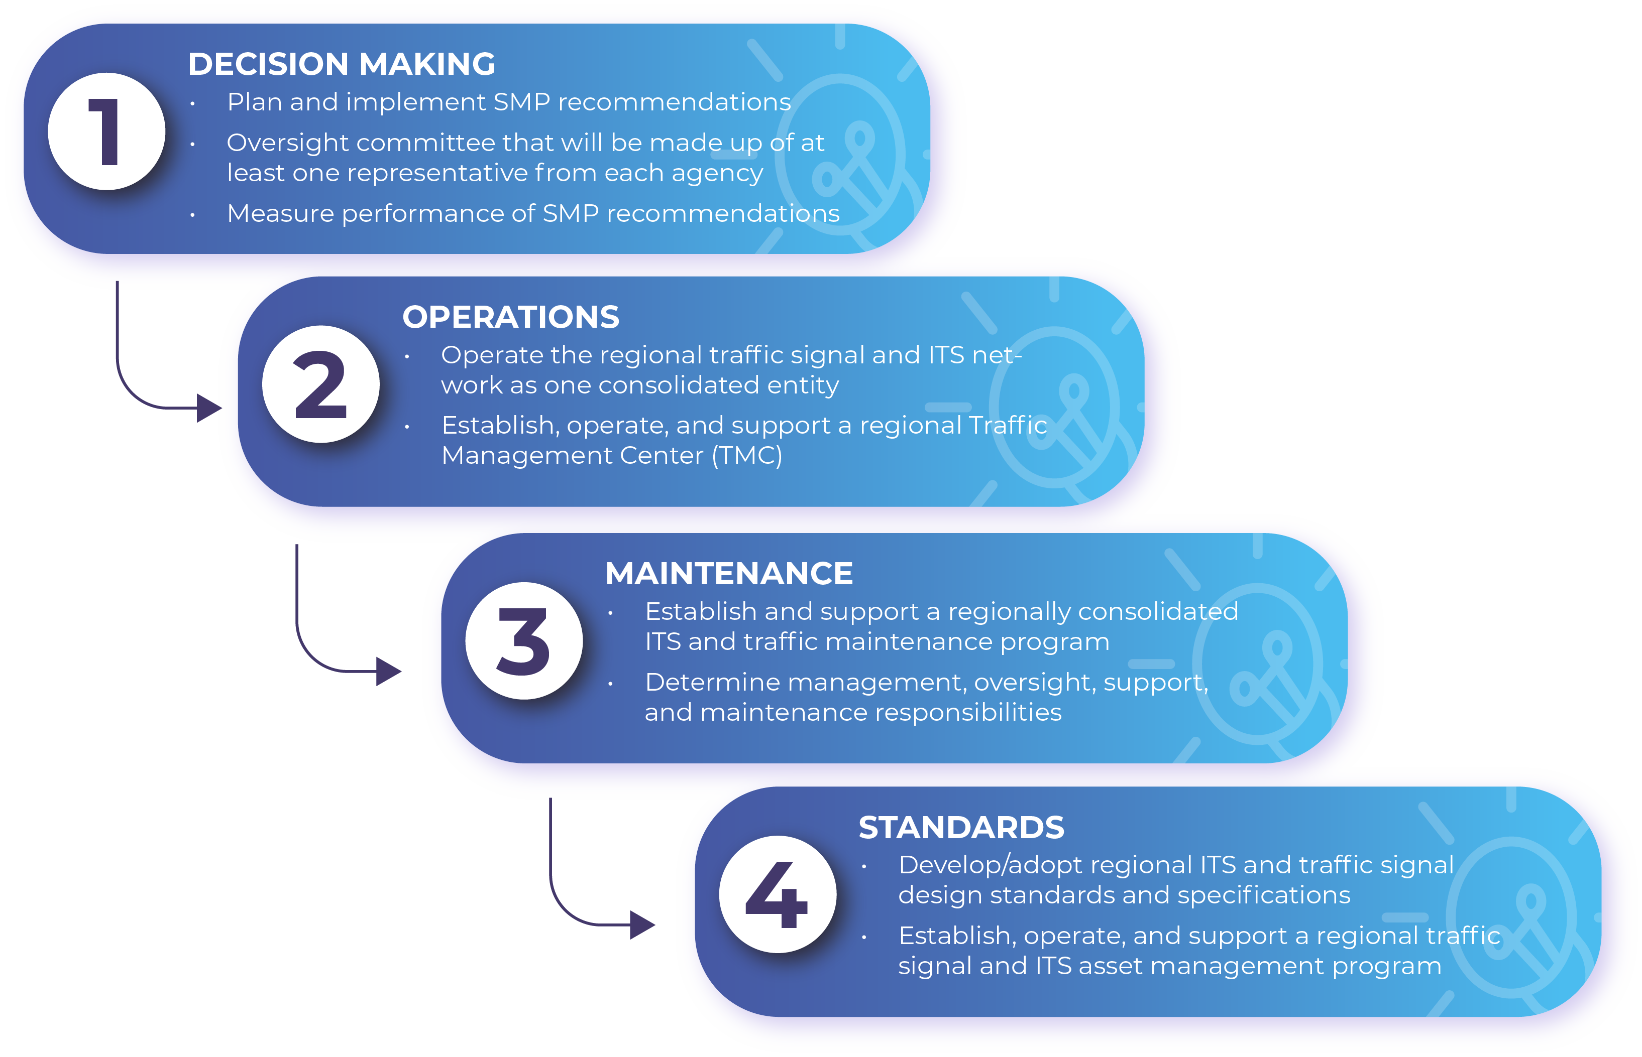
RTC Engineering Activities
TSMO
  Capability and Maturity Model
  Regional TMC
  Updates to ITS Strategic Master Plan

Slide 23
Thank You!
Jeff Wilbrecht, P.E.
Engineering Manager
jwilbrecht@rtcwashoe.com
Building A Better Community Through Quality Transportation

